Slide 1
Sugar Brain Lab notebook

Slide 2
Notes about the computer codes
BDM matlab <-runs a variety of programs
Pygain.py<- python code
Put photos in stim
Notes:
Akrahm button box version

Slide 3
Cracking codes
Python_liquid.py (on GIThub)
Psychopy.py (on IRC mac)
Pygame.py (on IRC mac)

Slide 4
Scanning procedure
Davis_001
1. Localizer
2. AA head_scout
3. Fieldmap
4. Resting state fMRI MBEP1
Append
5. Resting state fMRI MBEP1
Run twice
6. T1 WMPRI
7. T2 WSPCI
Food paradigm
gustamotor
Anatomical
Notes:
Stop the fMRI once the task is over

Slide 5
Quick notes
Set up both tasks at once
Start with food choice
Make sure button box works
Click on the buttons with a text window open
Text should appear in the window
It should be BYGRT
Projector must be on USB 2X4 BYGRT

Slide 6
Notes 41914
1+ hour set up
Hh sc 2x4-C BYGR HID key
Night before set up gustometer and check button box
Morning, plug in gustometer
Set up tasks

Slide 7
How to run the gustamotor
Log into liquid
SugarBrain
Connect the gustometer to the computer
Before running anything make sure the USB is plugged in
Make sure the button box is on

Slide 8
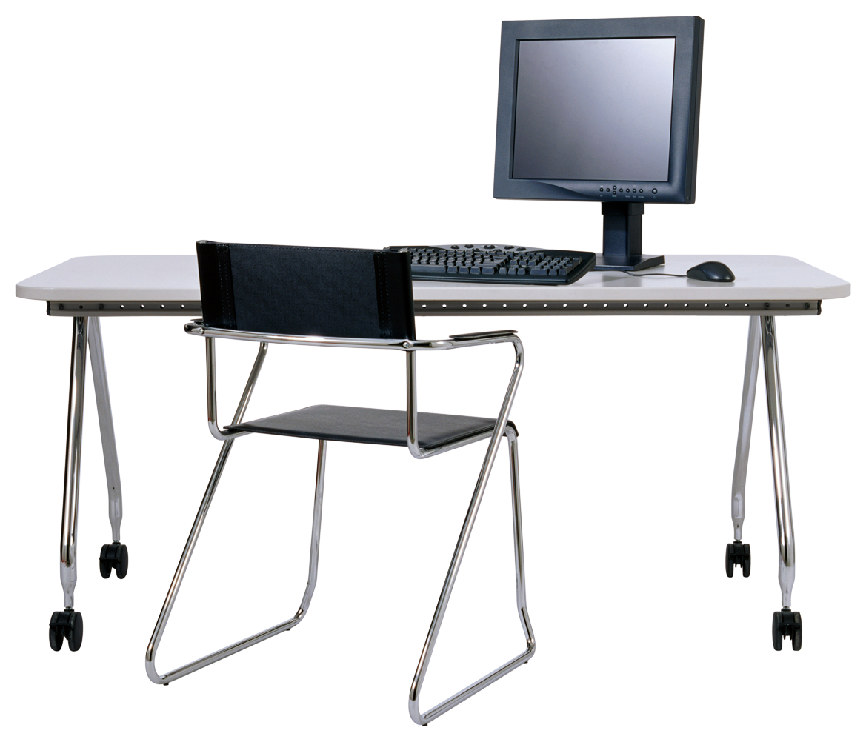
The Set Up
USB cable
Ethernet cable
Connect to network on neutral pump and computer on flavor pump
Ethernet to USB
Connect to
Computer socket
Comp
Net
Comp
Neutral Pump
Flavor pump

Slide 9
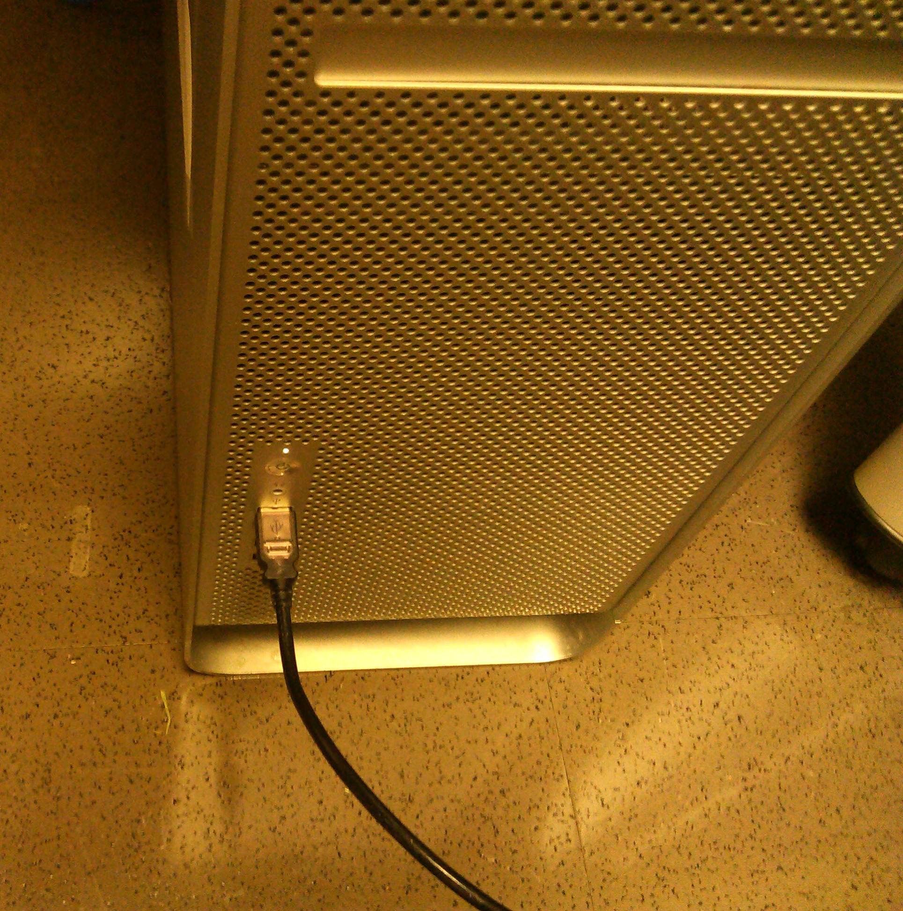
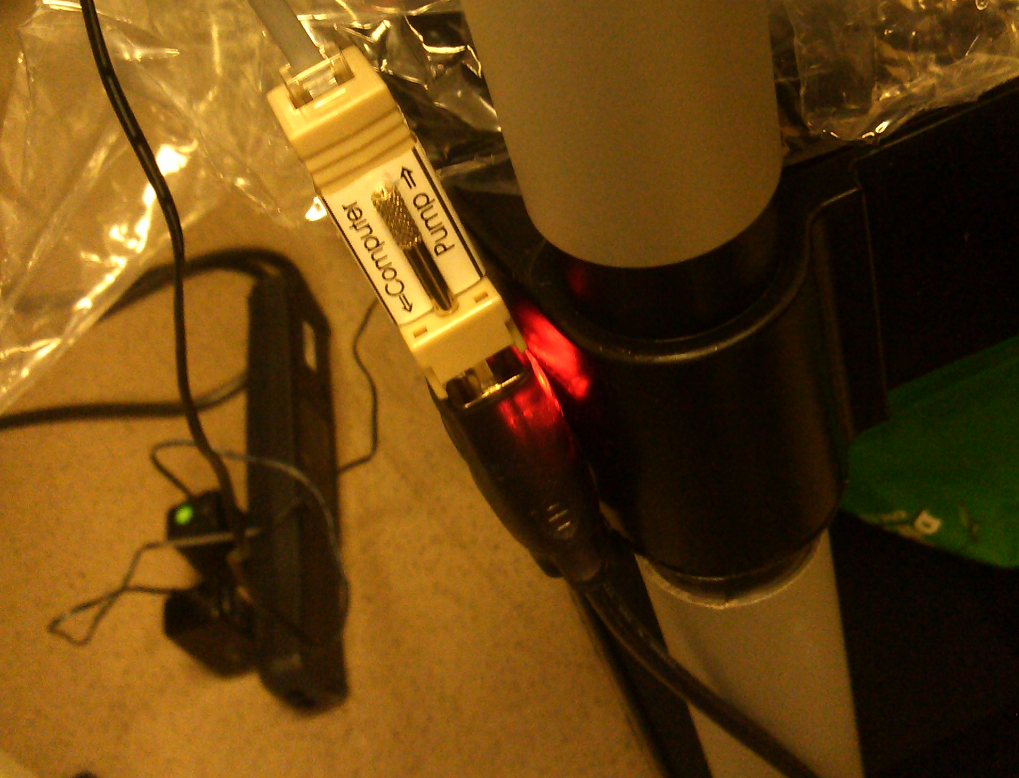

Slide 10
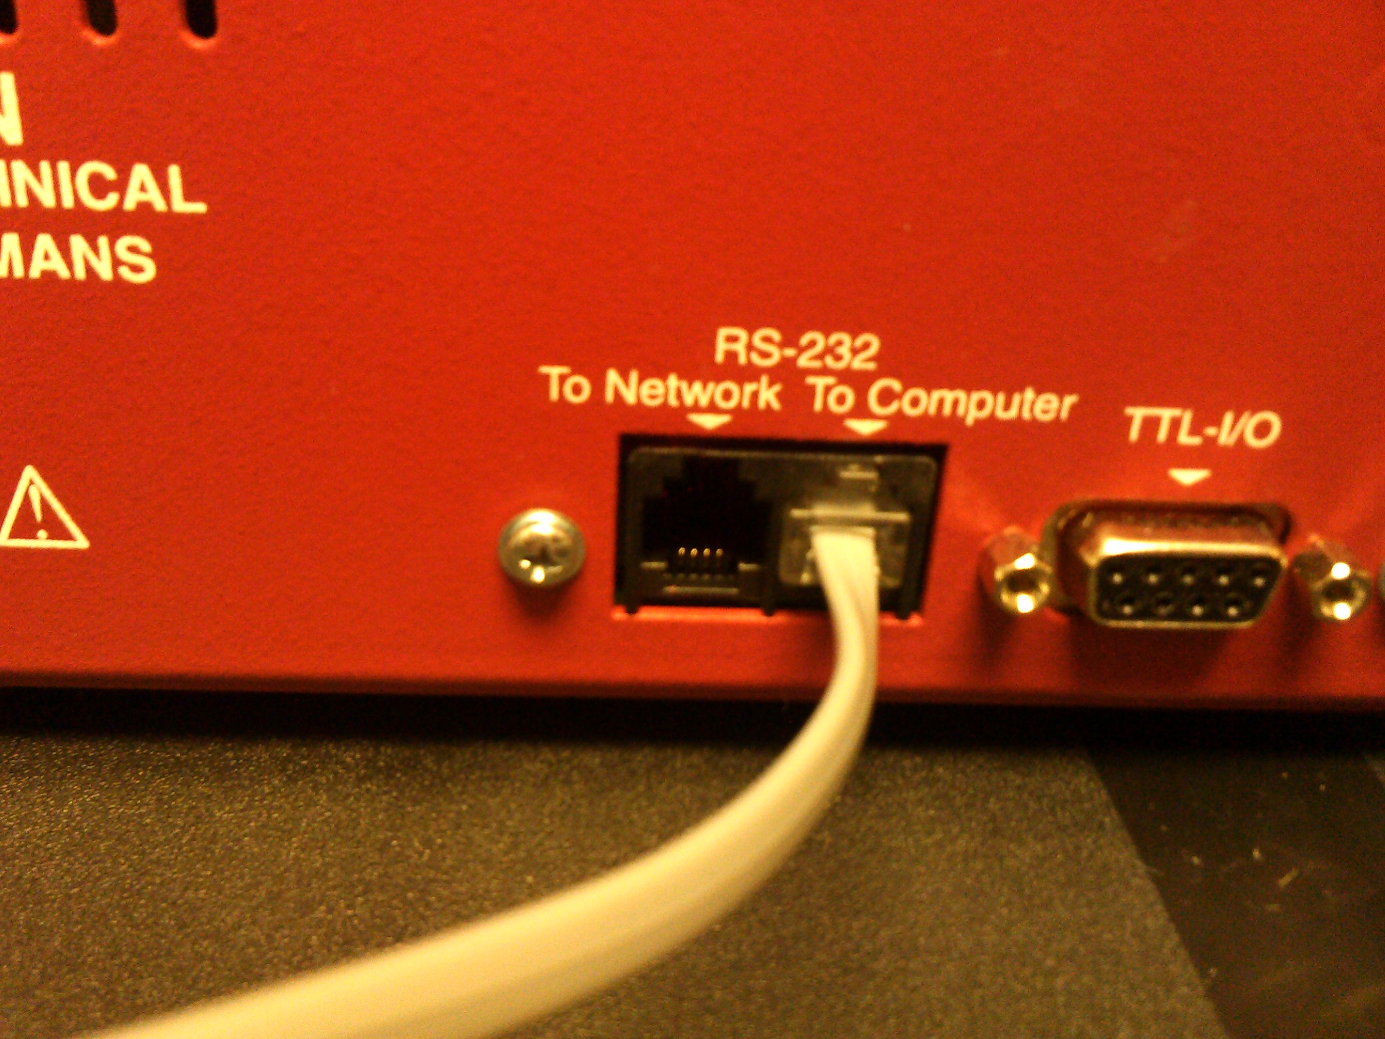
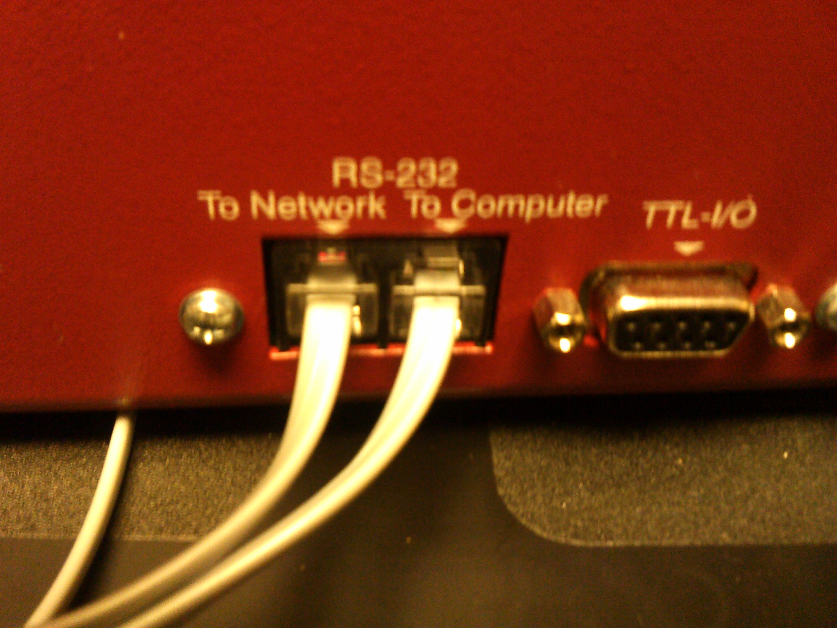
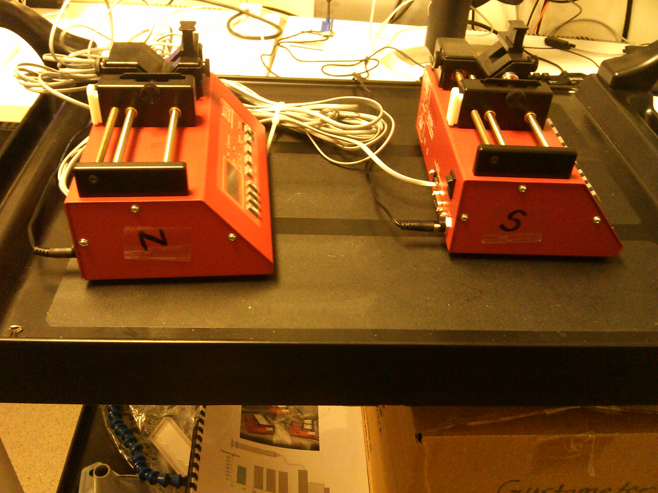
Neutral=0
Flavor=1

Slide 11
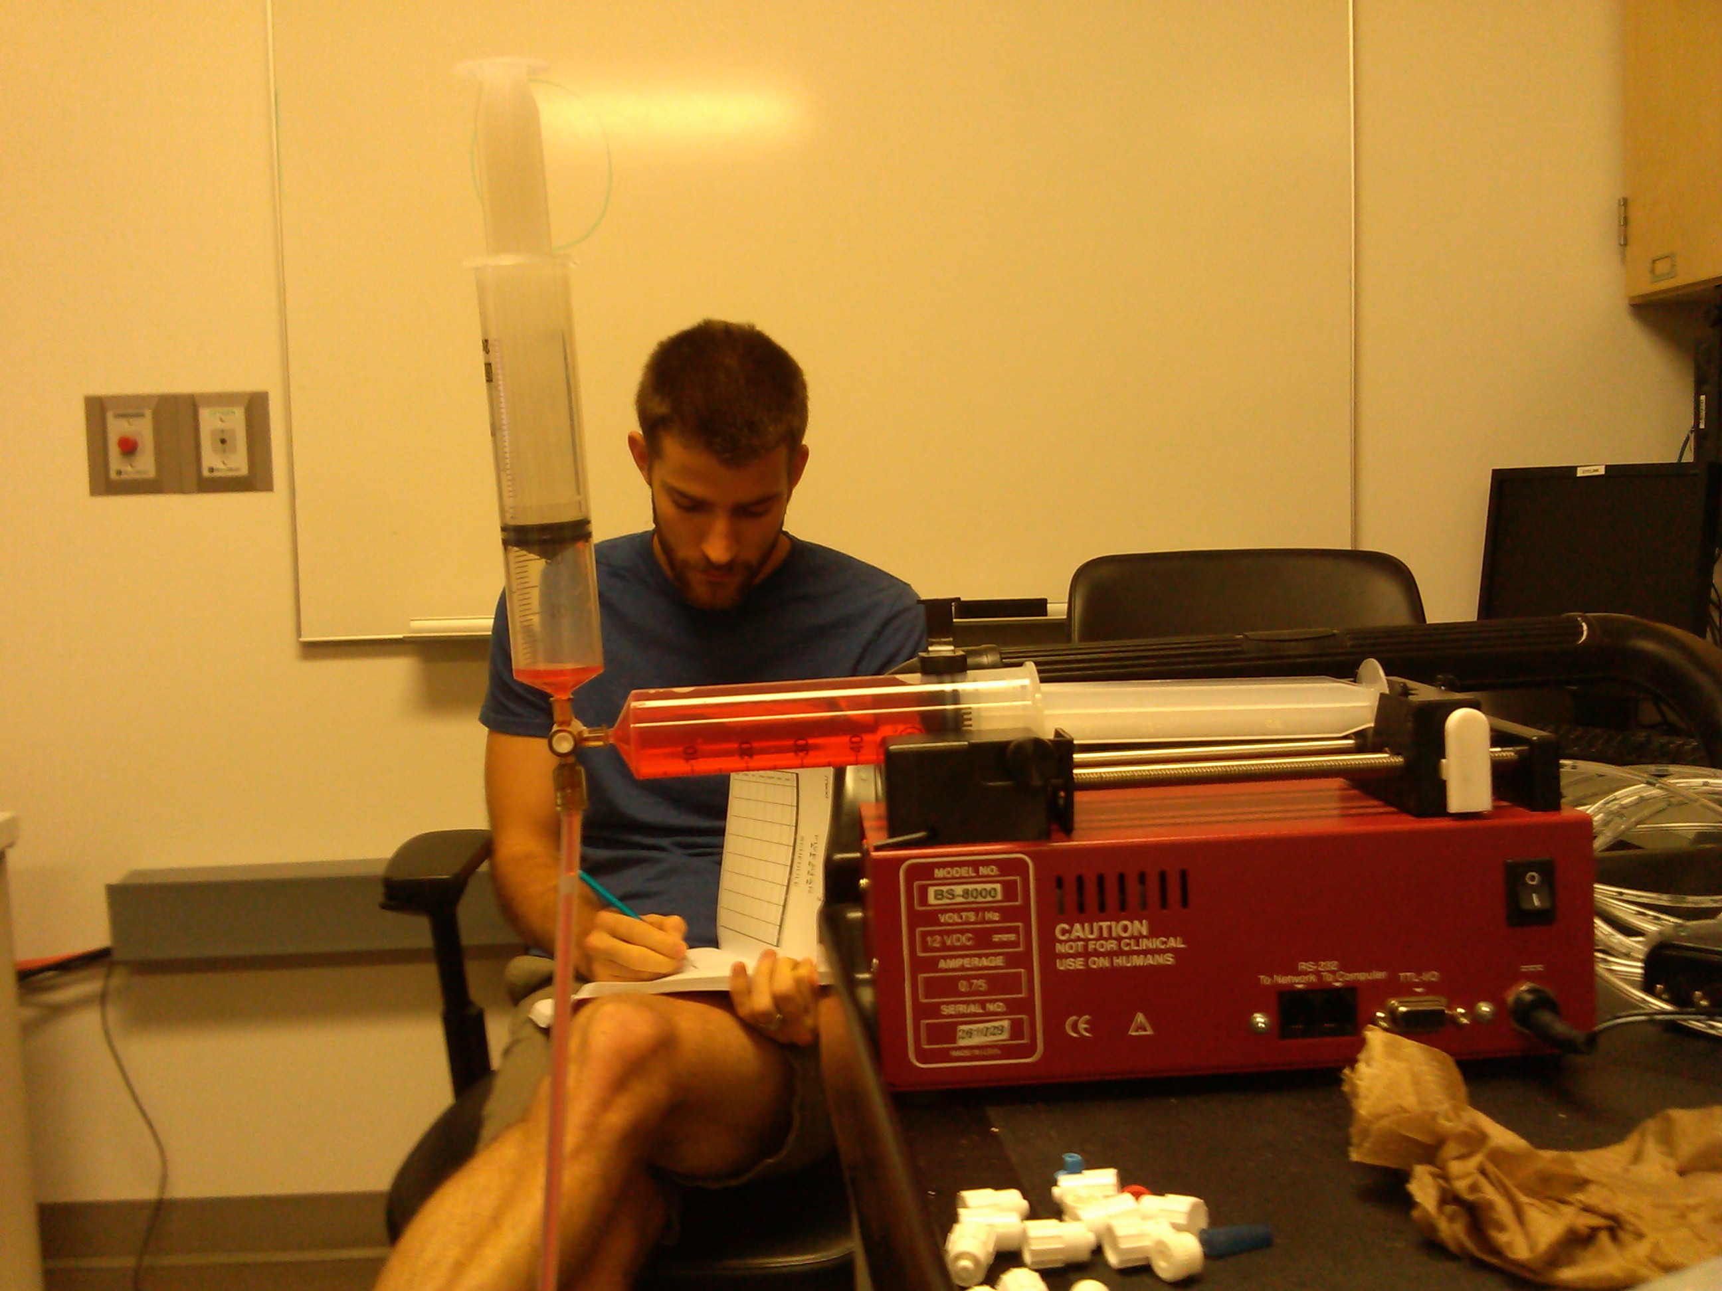
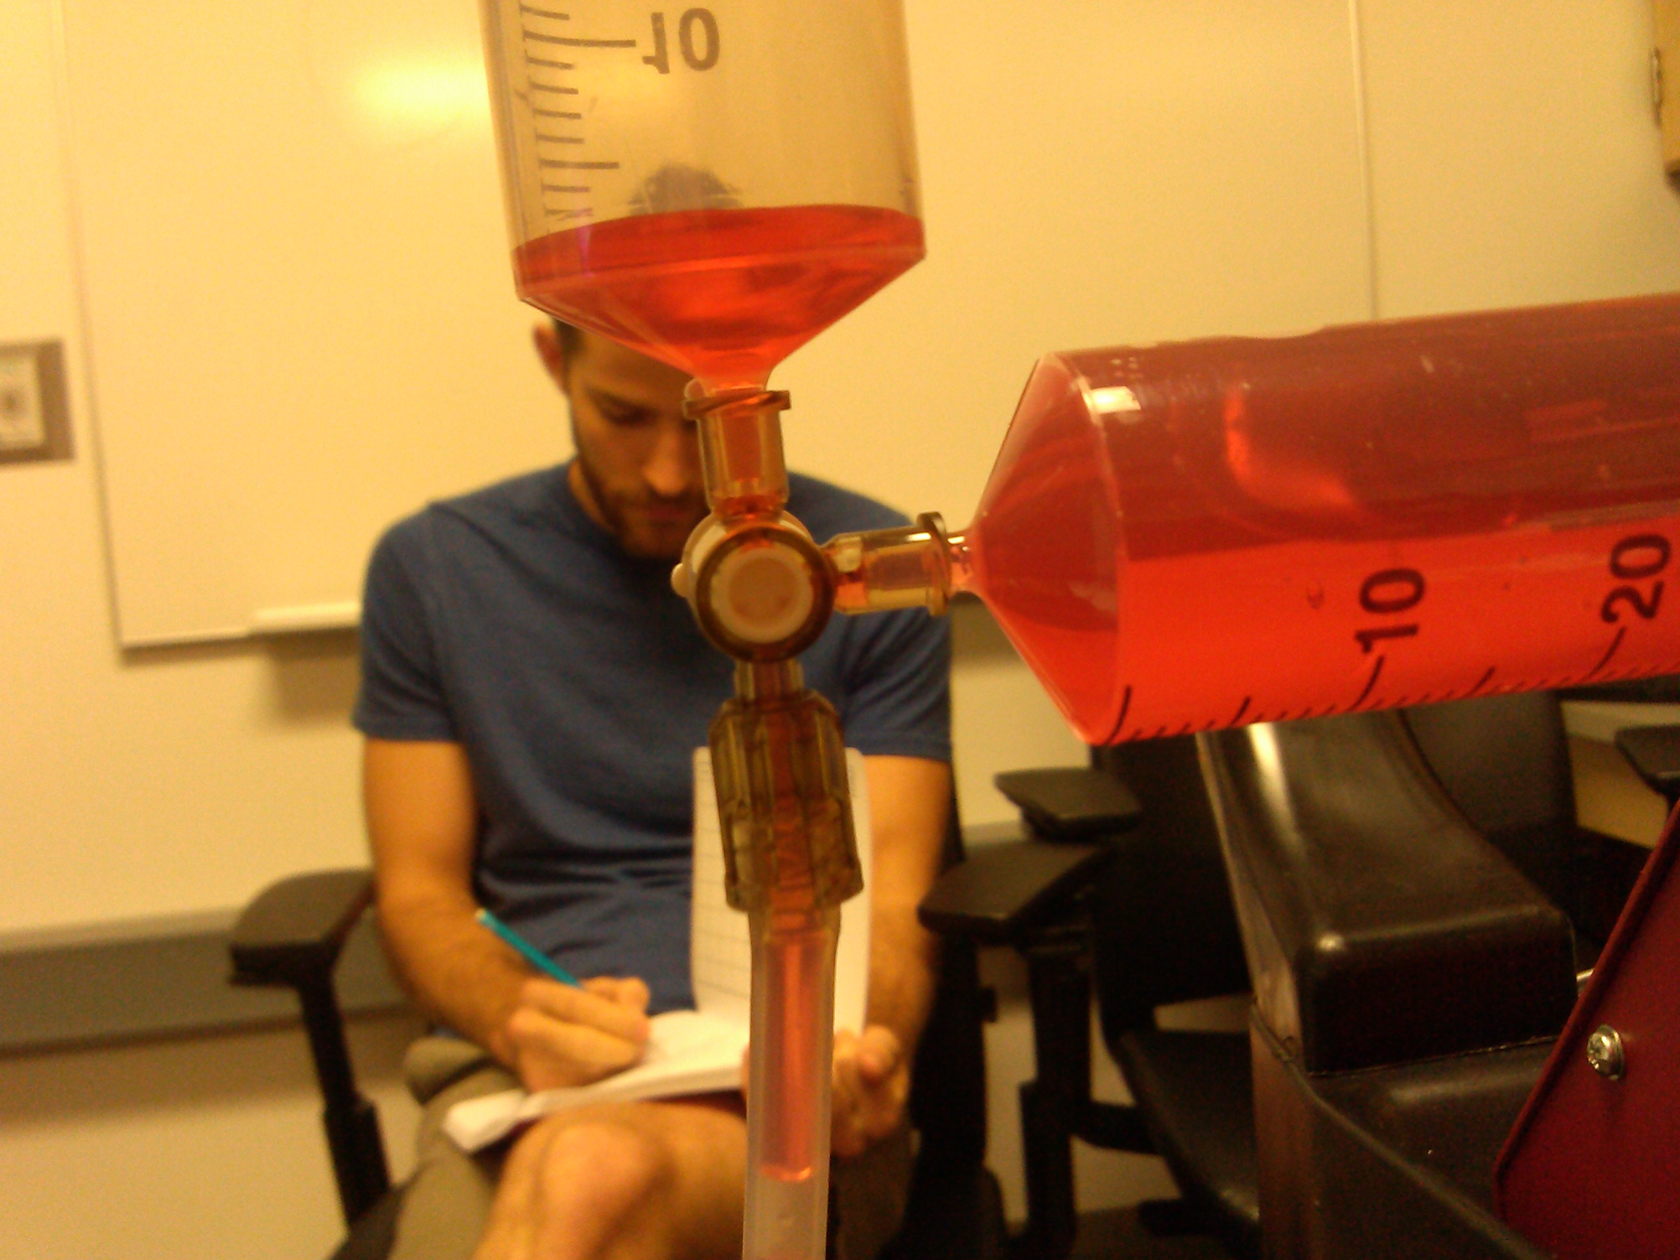
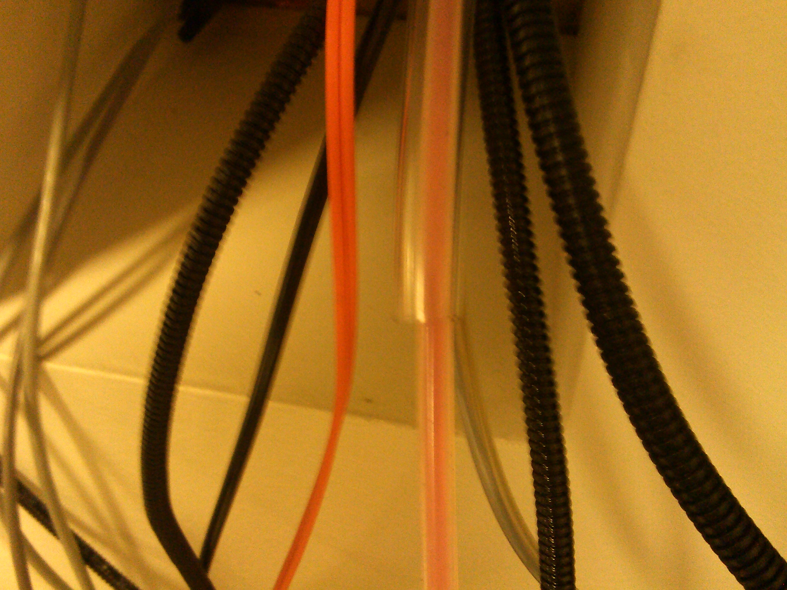
Double syringe to maintain pressure
BD connecta
P#: 394910
Double stopcock to seamlessly maintain pressure
Double tubing through the waveguide

Slide 12
Type: cd[space]Applications/liquid[enter]
Type: ls (check if everything is there)
Python[space]liquid.py (the command to begin the pump
Press 5 when ready to begin, or will initialize with the scan
Shows trial 0
Showing water
Injecting water
Rinse water
0=water
1=flavor
Notes:
How to run the python code

Slide 13
Cue
2s
0.5mL
Delivery
2s
Wait
2s
0.5mL
Rinse
2s
Swallow
2s
Jitter
5-10s
Cue
2s
events
0.5mL
Delivery
2s
Wait
2s
0.5mL
Rinse
2s
Swallow
2s
Jitter
5-10s
Block
Cue
2s
0.5mL
Delivery
2s
Wait
2s
0.5mL
Rinse
2s
Swallow
2s
Jitter
5-10s
Cue
2s
0.5mL
Delivery
2s
Wait
2s
0.5mL
Rinse
2s
Swallow
2s
Jitter
5-10s

Slide 14
Totals
The line holds 85mL
Need 6 mL tampico
Need 12 mL spit
Total time
8 minutes
4 minutes per section
2 runs
8 valid blocks
4 invalid blocks
2s per event
10s per block
10s jitter

Slide 15
Data storage
Data is stored in liquid->output->files
Take the file and save to dropbox
Food paradigm data is saved in a txt file in matlab
Also save to dropbox

